Slide 1
CSE 3521:Bayesian Networks (DAG Probabilistic Graphical Models)
[Many slides are adapted from previous CSE 5521 course at OSU.]

Slide 2

Project Submission
Presentation
Same section group: During class time
Multi section group: You can choose which time to present
(and update it in the project sheet)
Report
Tentatively 4 pages
1-2 pages the problem description and dataset description
1-2 pages the algorithm description and performance report
½ page comparison among the algorithms and conclude

Slide 3
Today
Probabilistic graphical models (PGMs)
An efficient way to encode conditional independence
From PGMs, we can decompose a joint probability much efficiently
Probabilistic Inference on PGMs
Independence in PGMs

Slide 4
Problems: dependent feature variables
Most real-world data have high-dimensional and correlated variables
Examples:
Pixels in an image
Words in a document
Genes in a microarray
Sometimes, even data instances are not independent
Examples:
Today’s stock market and yesterday’s stock market

Slide 5

Questions: how to build probability models?
How to compactly represent $p(X=x|θ)$, where $θ$ are the parameters?
How can we use this distribution to infer a set of variables given another?
Ex. Given the first 100 pixels, infer the rest
Ex. Given today’s stock market, predict tomorrow’s
How can we learn the parameters with a reasonable amount of data?

Slide 6
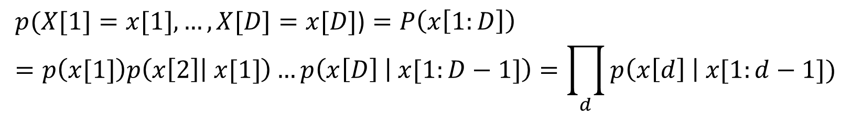
The Chain Rule of Probability
$$p(X[1]=x[1],…,X[D]=x[D]\text{)}=P\left(x\left[1:D\right]\right) \\ =p\left(x[1]\right)p\left(x\left[2\right] | x[1]\right)…p\left(x\left[D\right] | x[1:D−1]\right)=\prod_{d}{p\left(x\left[d\right] \right| x[1:d−1])}$$
$$p(X_{1}=x_{1},…, X_{N}=x_{N}\text{)}=p\left(x_{1:N}\right)=p\left(x_{1}\right)p\left(x_{2} | x_{1}\right)…p\left(x_{N} | x_{1:N−1}\right)=\prod_{i}{p(x_{i}|x_{1:i−1})}$$
We will use $x[i]$ or $x_{i}$ interchangeably sometimes in this lecture!
Can represent any joint distribution this way
Using any ordering of the variables…
Problem: this distribution has O(2^{N}) parameters if each of them is a binary random variable

Slide 7
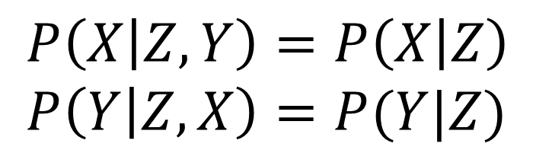
Conditional Independence
This is the key to representing large joint distributions
X and Y are conditionally independent given Z
if and only if the conditional joint can be written as a product of the conditional marginals
$$P\left(X | Z, Y\right)=P\left(X | Z\right) \\ P\left(Y | Z, X\right)=P(Y|Z)$$

Slide 8
Markov Models
“The future is independent of the past given the present”
Only O(N) parameters:
Fewer parameters, (1) faster learning, (2) fast inference, (3) and fewer training data required!

Slide 9
Probabilistic Graphical Models
First order Markov assumption is useful for 1-D sequence data
Sequences of words in a sentence or document
Q: What about 2-D images, 3-D video
Or in general arbitrary collections of variables
Gene pathways, etc…

Slide 10
Probabilistic Graphical Models
A way to represent a joint distribution by making conditional independence assumptions
Nodes represent variables
Edges: can be directed or undirected
directed acyclic graph (DAG): Bayesian networks
No edges indicate conditional independence assumptions
Ex: (top) C and B are conditionally independent given A
A
B
C
D
A
B
C
D

Slide 11
Graph Terminology
A
B
Graph (V,E) consists of
A set of nodes or vertices V={1, …, V}
A set of edges {(s, t) in V}
Childs/Parents (for directed graphs)
Ancestors (for directed graphs)
Decedents (for directed graphs)
Neighbors (for any graphs)
Cycle (for any graphs)
Tree (no cycles)
Clique / Maximal Clique (for directed graphs): (sub) complete graph
C
D
A
B
C
D

Slide 12
Directed Graphical Models
A
B
Graphical Model whose graph is a DAG
DAG: Directed acyclic graph (no cycles!)
A.K.A. Bayesian Networks
Also known as Bayes network, belief network
Nothing inherently Bayesian about them
Just a way of defining conditional independence
C
D

Slide 13
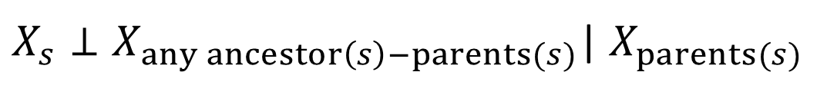
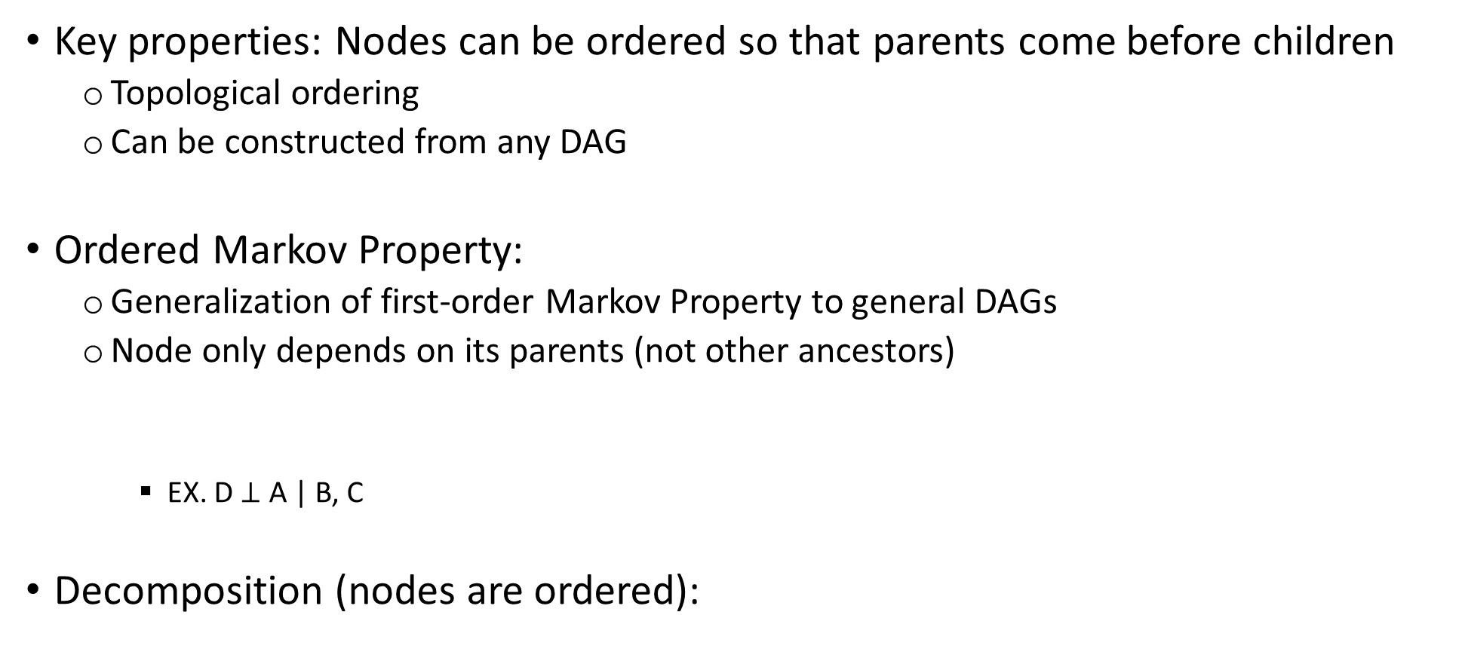
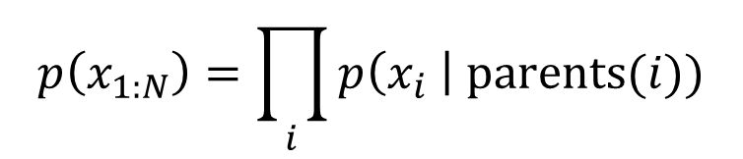
Directed Graphical Models
Key properties: Nodes can be ordered so that parents come before children
Topological ordering
Can be constructed from any DAG
Ordered Markov Property:
Generalization of first-order Markov Property to general DAGs
Node only depends on its parents (not other ancestors)
EX. D $⊥$ A | B, C
Decomposition (nodes are ordered):
A
B
C
D
$X_{s}⊥X_{any ancestor\left(s\right)−parents(s)}$| $X_{parents(s)}$
$$p\left(x_{1:N}\right)=\prod_{i}{p\left(x_{i} \right| parents(i))}$$

Slide 14
Example
X₁
Given the decomposition, you can draw the DAG
Given the DAG, you can derive the decomposition
X₂
X₃
X₄
X₅

Slide 15
Practice
A
B
$$P\left(A,B,C,D\right)=P\left(A\right)P\left(B | A\right)P\left(C | A\right)P(D|B,C)$$
C
D

Slide 16
Practice
D
C
$$P\left(A,B,C,D\right)=P\left(A | D\right)P\left(B | A\right)P\left(C | B, A\right)P(D)$$
A
B

Slide 17
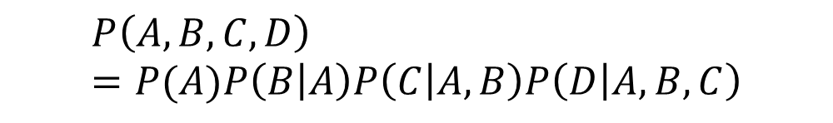
Practice
A
B
$$P\left(A,B,C,D\right)=P(A)P\left(B | A\right)P\left(C | A,B\right)P\left(D | A,B,C\right)$$
C
D

Slide 18
Naïve Bayes
White nodes: unknown
Gray nodes: observed

Slide 19
Example: medical Diagnosis (The Alarm Network)

Slide 20
Another medical diagnosis example: QMR network
Diseases
Symptoms

Slide 21
Today
Probabilistic graphical models (PGMs)
An efficient way to encode conditional independence
From PGMs, we can decompose a joint probability much efficiently
Probabilistic Inference on PGMs
Independence in PGMs

Slide 22
Probabilistic Inference
Graphical Models provide a compact way to represent complex joint distributions
Q: Given a joint distribution, what can we do with it?
A: Main use = probabilistic inference
Estimate unknown variables from known ones
Ex. Given P(X, Y), predict the most likely assignment of Y given X=x

Slide 23
General Form of Inference
We have:
A correlated set of random variables
Joint distribution:
Assumption: parameters are known
Partition variables into:
Visible (with assignments/observations):
Hidden:
Goal: compute unknowns from known ones

Slide 24
General Form of Inference
Condition data by clamping visible variables to observed values
Normalize by probability of evidence

Slide 25
Nuisance Variables
Partition hidden variables into:
Query Variables (interested):
Nuisance variables (not interested):

Slide 26
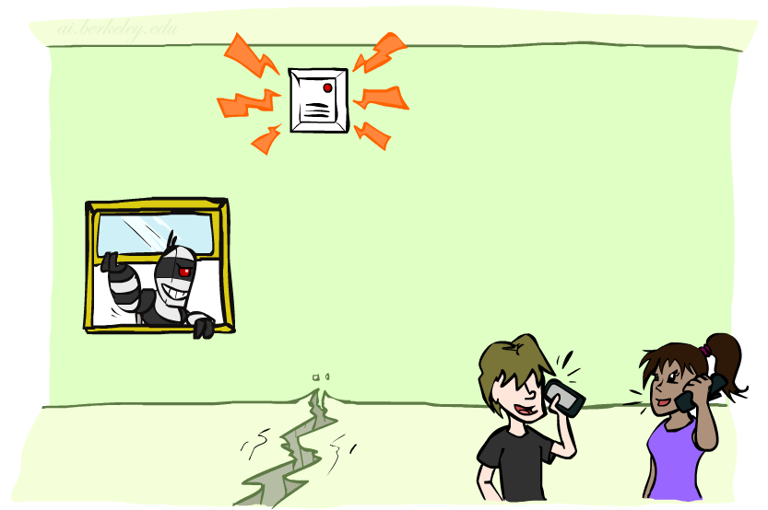
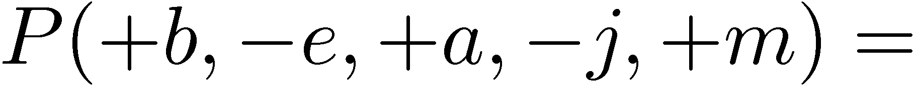
Inference on PGMs
Burglary
B | P(B)
+b | 0.001
-b | 0.999
B
E
E | P(E)
+e | 0.002
-e | 0.998
Earthquake
Alarm
A
A | J | P(J|A)
+a | +j | 0.9
+a | -j | 0.1
-a | +j | 0.05
-a | -j | 0.95
A | M | P(M|A)
+a | +m | 0.7
+a | -m | 0.3
-a | +m | 0.01
-a | -m | 0.99
B | E | A | P(A|B,E)
+b | +e | +a | 0.95
+b | +e | -a | 0.05
+b | -e | +a | 0.94
+b | -e | -a | 0.06
-b | +e | +a | 0.29
-b | +e | -a | 0.71
-b | -e | +a | 0.001
-b | -e | -a | 0.999
J
M
John Calls
Mary Calls

Slide 27

Inference on PGMs
Burglary
B | P(B)
+b | 0.001
-b | 0.999
B
E
E | P(E)
+e | 0.002
-e | 0.998
Earthquake
Alarm
A
A | J | P(J|A)
+a | +j | 0.9
+a | -j | 0.1
-a | +j | 0.05
-a | -j | 0.95
A | M | P(M|A)
+a | +m | 0.7
+a | -m | 0.3
-a | +m | 0.01
-a | -m | 0.99
B | E | A | P(A|B,E)
+b | +e | +a | 0.95
+b | +e | -a | 0.05
+b | -e | +a | 0.94
+b | -e | -a | 0.06
-b | +e | +a | 0.29
-b | +e | -a | 0.71
-b | -e | +a | 0.001
-b | -e | -a | 0.999
J
M
John Calls
Mary Calls

Slide 28
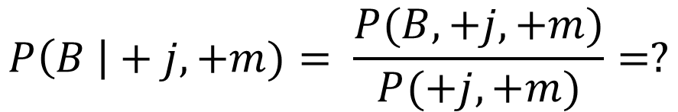
Inference on PGMs
Burglary
B | P(B)
+b | 0.001
-b | 0.999
B
E
E | P(E)
+e | 0.002
-e | 0.998
Earthquake
Alarm
A
A | J | P(J|A)
+a | +j | 0.9
+a | -j | 0.1
-a | +j | 0.05
-a | -j | 0.95
A | M | P(M|A)
+a | +m | 0.7
+a | -m | 0.3
-a | +m | 0.01
-a | -m | 0.99
B | E | A | P(A|B,E)
+b | +e | +a | 0.95
+b | +e | -a | 0.05
+b | -e | +a | 0.94
+b | -e | -a | 0.06
-b | +e | +a | 0.29
-b | +e | -a | 0.71
-b | -e | +a | 0.001
-b | -e | -a | 0.999
J
M
John Calls
Mary Calls
$$P\left(B \right|+j, +m)= \frac{P(B,+j, +m)}{P(+j, +m)}=?$$

Slide 29
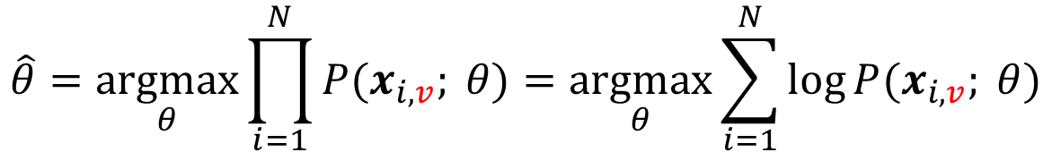
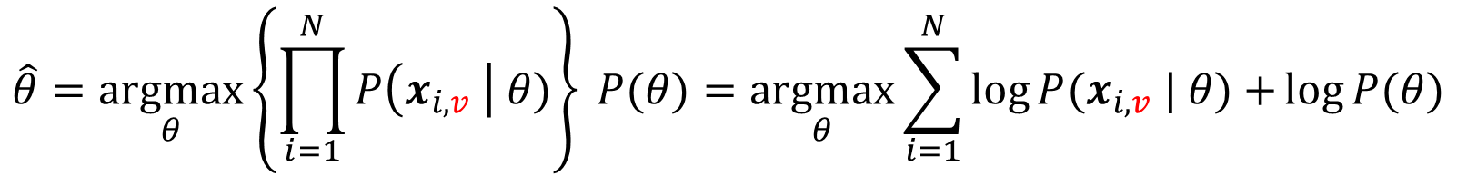
** Inference vs. Learning
Inference:
Compute
Parameters are assumed to be known
Learning (parameter estimation):
Compute MLE or MAP estimate of the parameters
$$\hat{θ}=\underset{θ}{argmax}{\prod_{i=1}^{N}{P(x_{i,v}; θ)}}=\underset{θ}{argmax}{\sum_{i=1}^{N}{\log{P(x_{i,v}; θ)}}}$$
$$\hat{θ}=\underset{θ}{argmax}\left\{\prod_{i=1}^{N}{P\left(x_{i,v} \right| θ)}\right\} P(θ)=\underset{θ}{argmax}{\sum_{i=1}^{N}{\log{P(x_{i,v} | θ)}}+}\log{P(θ)}$$

Slide 30
Today
Probabilistic graphical models (PGMs)
An efficient way to encode conditional independence
From PGMs, we can decompose a joint probability much efficiently
Probabilistic Inference on PGMs
Independence in PGMs

Slide 31
Markov Blanket
Definition:
The smallest set of “observed” nodes that renders a node t conditionally independent of all the other nodes in the graph.
Markov blanket in DAG is:
Parents
Children
Co-parents (other nodes that are also parents of the children)

Slide 32
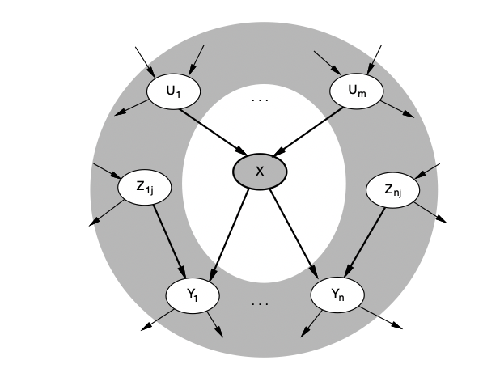
Markov Blanket
Each node is conditionally independent of all others given its Markov blanket:
parents + children + children’s parents

